Slide 1
The Impact of Risk Factors on Diabetes
Jessica Mccarty, Armando Zamora, Casandra Murray, Evelyn browning

Slide 2
Executive Summary
Initial focus: Indicators of diabetes across U.S. regions.
Challenge: Insufficient and unreliable data for accurate forecasting
Pivot: Shifted analysis to new data from the Pima Indians, a Native American population in Arizona, known for higher diabetes prevalence.

Slide 3
What is Diabetes?
Chronic condition where the body struggles to manage insulin, leading to high blood sugar levels.
Type 1: Body doesn't produce insulin.
Type 2: Body can't use insulin effectively.
Health Impact: Uncontrolled diabetes can cause serious long-term health issues.

Slide 4

Data Collection
Data Collection
We initially used CDC data to analyze diabetes prevalence across various U.S. states.
Our second dataset from Kaggle examined the relationship between diabetes and factors such as BMI, skin thickness, glucose levels, and pregnancy history. This dataset also included data from the Pima Indian population, a Native American group in Arizona with a higher incidence of diabetes.
During data cleaning, we replaced any missing values in the Kaggle dataset using the mean for the respective variables.
1st Data Sources:
CDC Data Source
2nd Data Sources:
Kaggle Diabetes Dataset
Dataset: CDC Data Source, Kaggle Diabetes Dataset
License: Public License.

Slide 5

Where in the U.S. is the risk of getting diabetes highest?

Slide 6
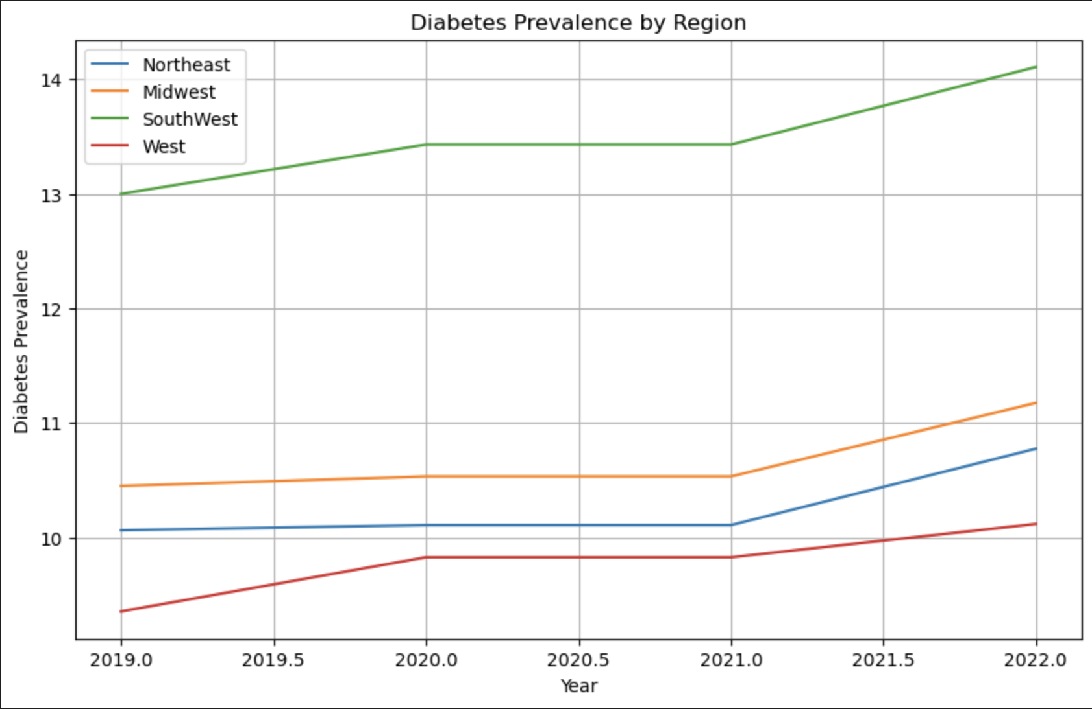
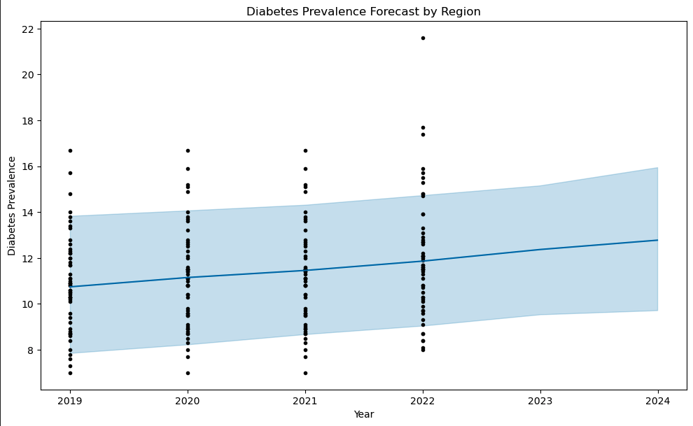
SouthWest Area of The US
The Southwest has the highest diabetes prevalence, followed by the Midwest, Northeast, and West regions. This trend reflects broader socio-economic and lifestyle factors in each area.
The graph indicates a gradual increase in diabetes prevalence across regions from 2019 to 2024, with some variability in prevalence across regions. There is more uncertainty in the forecasted values for later years (2023–2024)..

Slide 7

the pivot from prophet to logistic regression
Due to limitations in our dataset, which was already aggregated by year, we shifted from using the Prophet Forecasting Model to Logistic Regression. This method allowed us to better predict diabetes risk based on location and personal health factors.

Slide 8

Logistic Regression
Logistic regression is a statistical method used to predict the probability of an outcome, typically when the outcome is binary (like yes/no or true/false). It estimates the relationship between one or more variables and the likelihood of a specific result.

Slide 9

Do you think a family history of diabetes affects your risk of developing the condition?

Slide 10
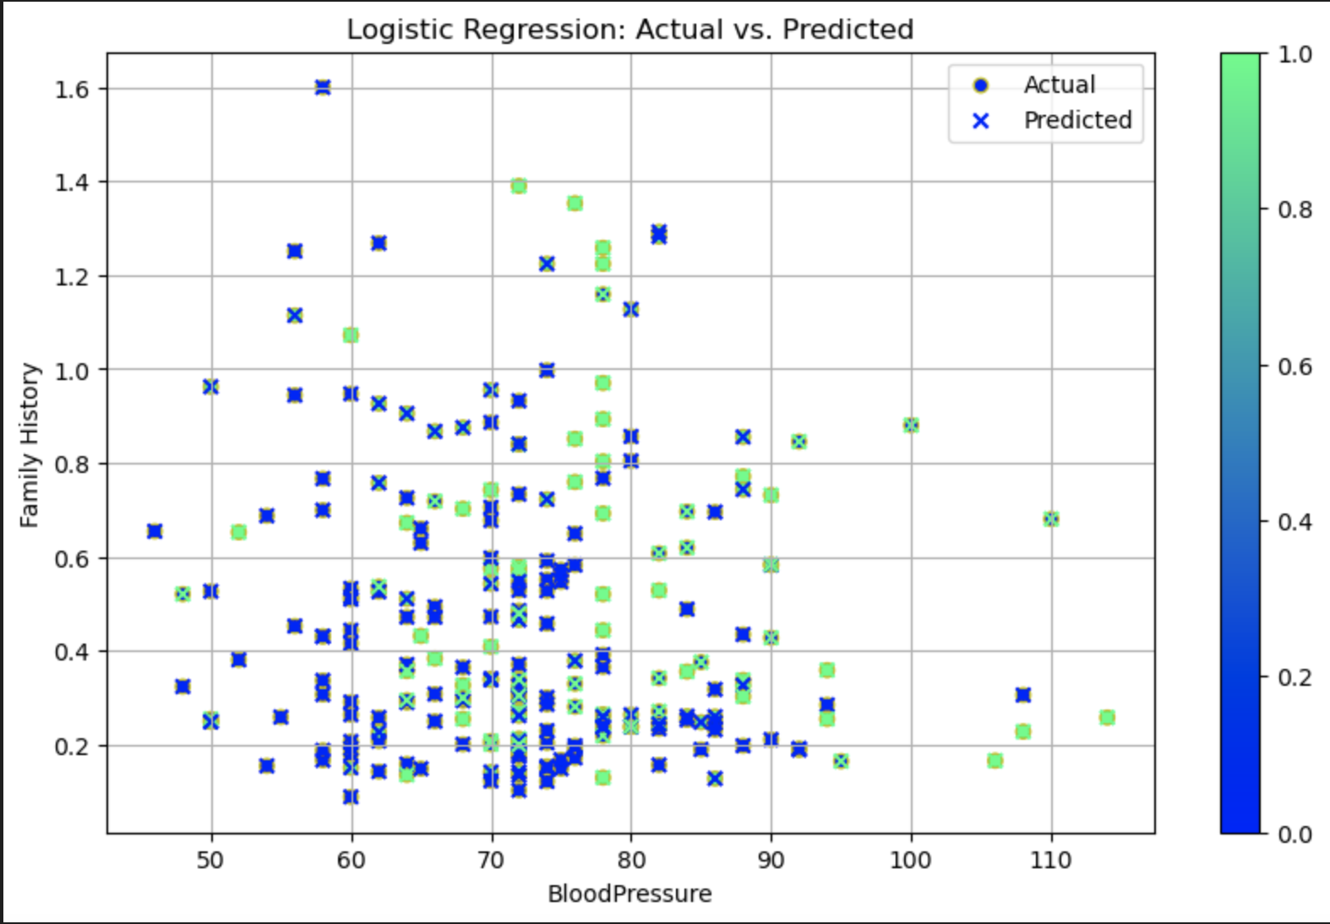
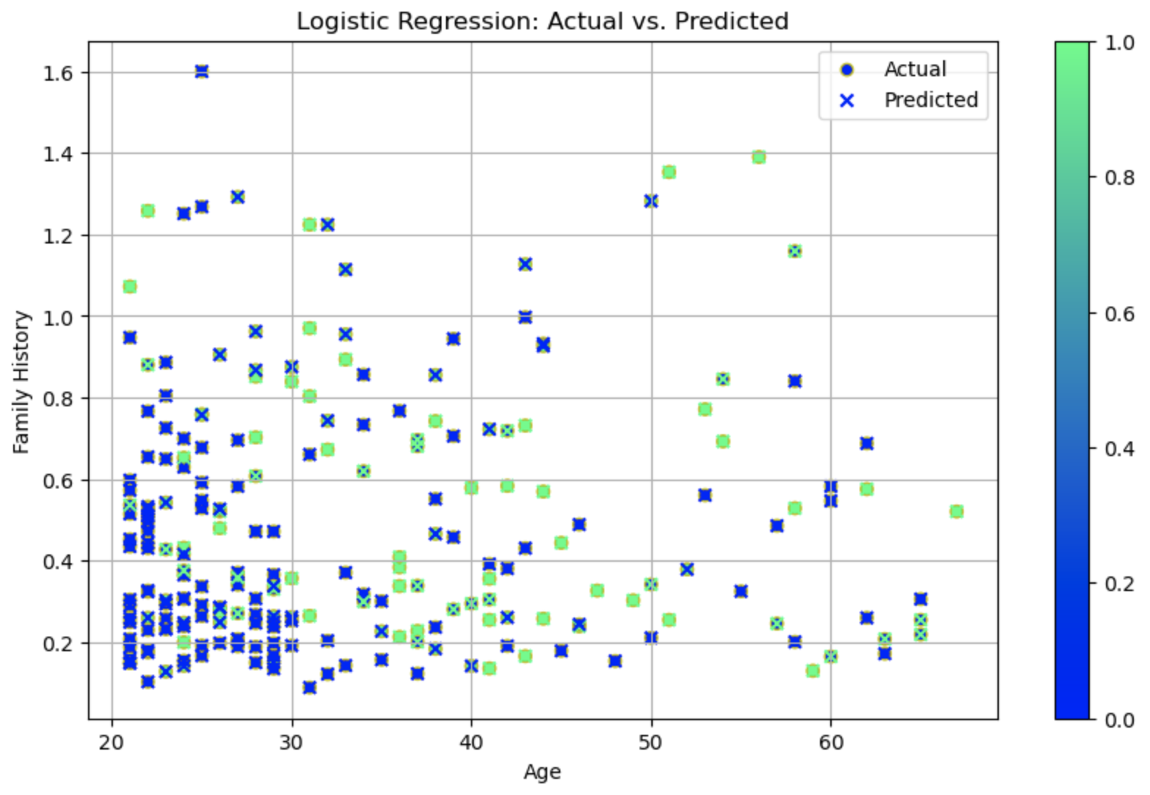
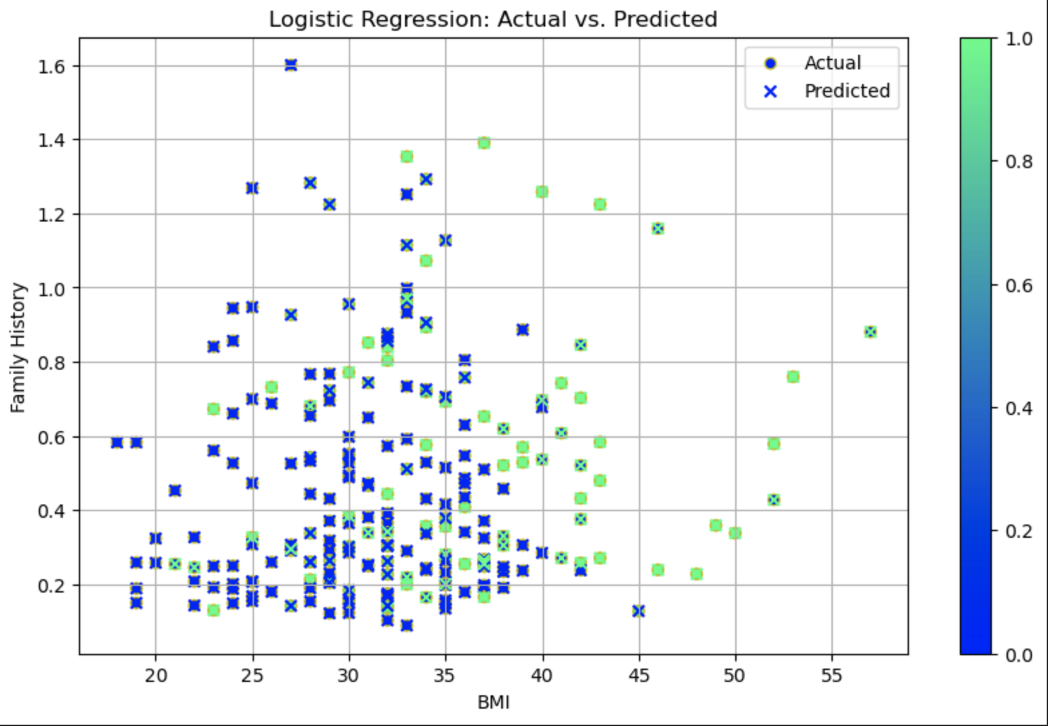
Family History
What the three graphs show is it doesn't impact you if you have a family of history of diabetes compared to other factors such as BMI, Age and glucose levels.
This would directionally indicate that lifestyle factors would be more relevant than family in assessing Diabetes risk.

Slide 11
How do other factors affect your likelihood of developing diabetes?

Slide 12
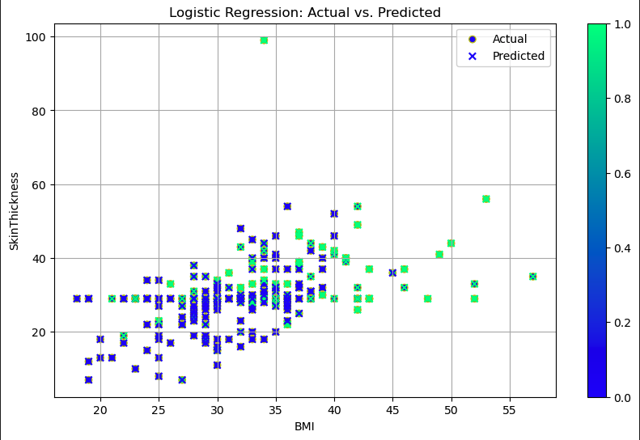
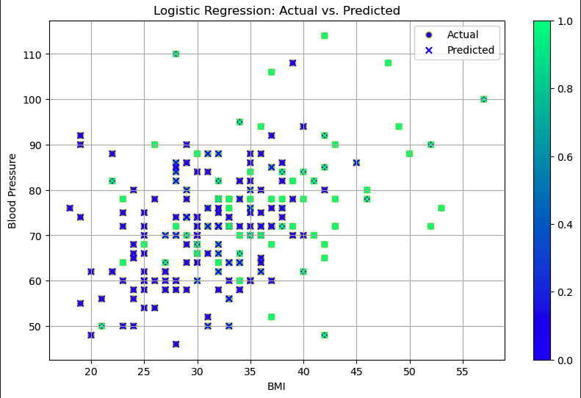
BMI
The actual and predicted points overlap well in some areas, particularly in the BMI range between 25 and 40. This suggests that the model is making relatively accurate predictions for individuals in this BMI range. For BMI values higher than 40, there appears to be a larger spread between the actual and predicted values, which suggests that the model's predictions are less accurate or the variance in skin thickness increases significantly as BMI increases.
The overlap between actual (green dots) and predicted (blue crosses) values is most noticeable in the BMI range of 20 to 40 and blood pressure range of 60 to 90. This suggests that the model is reasonably accurate in predicting blood pressure in this range.

Slide 13
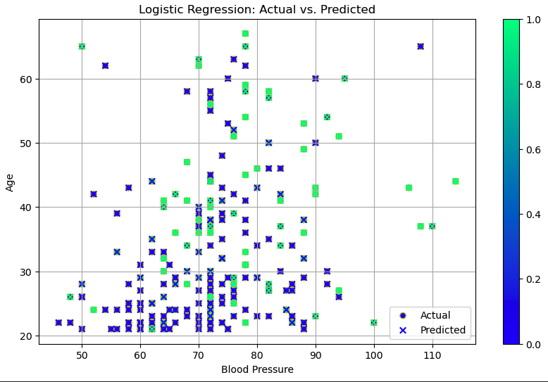
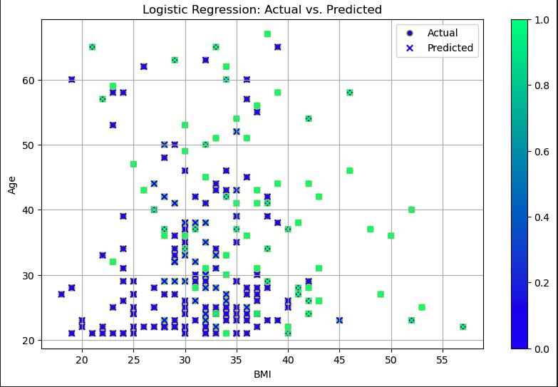
AGE
This graph compares actual vs. predicted blood pressure. With age on the y-axis and blood pressure on the x-axis. In summary, the model predicts blood pressure fairly well for younger individuals and average blood pressure ranges but struggles with outliers and older age groups.
This graph illustrates the comparison between actual and predicted BMI values. With age on the y-axis and BMI on the x-axis. In summary, the model is most effective in predicting BMI for younger age groups and moderate BMI ranges, but struggles with higher BMI and older individuals.

Slide 14
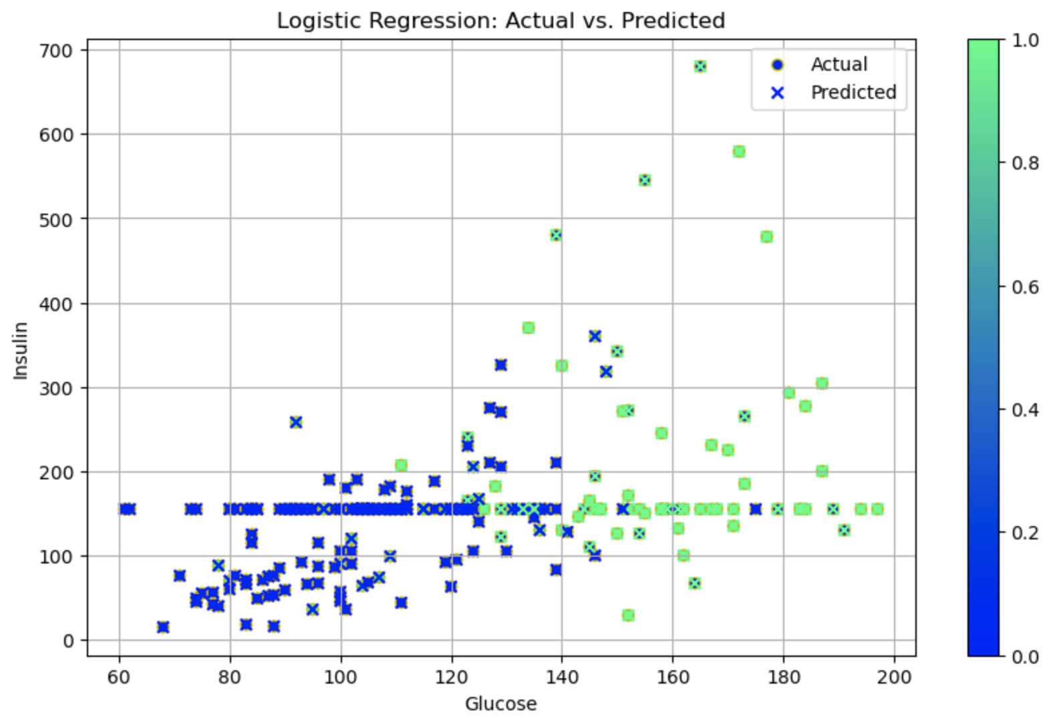
Glucose vs. Insulin
In this graph, you may notice a straight line around the value of 155. This occurs because the original dataset contained many zeros in this category. To clean the data, we replaced the zeros with the mean value for the respective category.

Slide 15
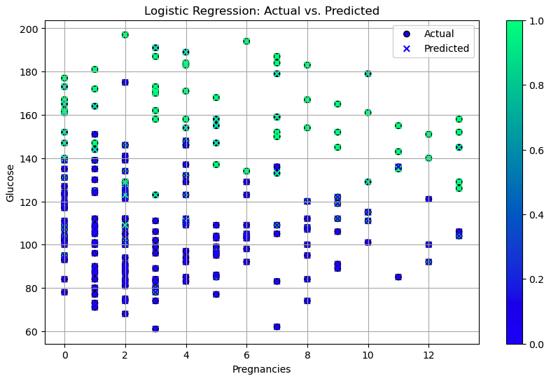
Pregnancy vs. Glucose
The logistic regression model performs well in predicting glucose levels for individuals with fewer pregnancies and moderate glucose ranges but struggles with higher glucose levels and increased pregnancies.

Slide 16
Additional Questions
Dig more into the Lifestyle Factors of the women.
Do the women have sedentary jobs that increase their chance of Diabetes.
What are their nutrition option and ability to get fruits and vegetables?
Notes:
If we had more time we would dig into the following questions.

Slide 17
Conclusion
Diabetes risk is heavily influenced by lifestyle factors such as BMI, glucose levels, and age. This means it is important for people to make healthy choices to reduce the likelihood of getting Diabetes. Regional data shows higher prevalence in the Southwest area.

Slide 18

Questions?
Thank you for your attention! What questions or insights do you have about how lifestyle and location influence diabetes risk?

